Slide 1
Descriptive Analysis And NLP Techniques
Reviews of Musical Instruments.

Slide 2

RoadMap
Overview of the Solution Developed
The Approach And Design
Key considerations
Analytical methodology
Outcomes
Proposed Next Steps
1 .
2 .
3 .
4 .
5 .
6 .

Slide 3

Overview of the solution developed
Understanding the Problem & Dataset
Finding the significance of all the columns
Text Cleaning and Processing
Exploratory Data Analysis
Create NLP model For Prediction & Evaluating the Model
Dividing Dataset for Training and Testing
Installing and Import Required Libraries And Dataset

Slide 4
design approach
Dataset Preparation
Identified key data elements & attributes , cleaning
Feature creation
EDA- Extract Data Analysis
Cleaning Data
Enriching the data
Modeling & Evaluation
Deploying ML Model
Building a pipeline framework that can be deployed in a production environment for continuous training and testing
Finding Data Incites
Designed the desired visualization.
Output visualization
Create ML model
Assess results based on test and train data

Slide 5
The Approach And Design
Approch:
The data set provided contain lots of text data which can be process with the help of Natural language processing and the creating ML models on top of the data processed. Hence we will be going with the NLPML implementations for the problem shared for solving
Understanding the Problem
Aim of the problem is extract and present key insights and recommendations from the dataset (including text attributes) using a combination of descriptive and natural language processing techniques.
Features available are:
reviewerID: Instrument reviewerId
asin: Instrument ID to identify the instruments uniquely
reviewerName: Number of person who has revived the Instrument
helpful: How helpful the relieves were
overall: The rating provided by the reviewer for the instrument
summary : The description about the product as provided by the reviewer
unixReviewTime: Unix time of the review
reviewTime: Date of the review

Slide 6
Key considerations
Columns : reviewerID , asin , reviewerName acts as identifiers and can be ignored
Column : helpful columns being a list value cannot be used by the ML model directly so need to find alternative way to save the value.(Here we take the ratio of the values present in the column)
Column : reviewText and summary have same level of information i.e if reviews bad summary wont be good so we can combine those column so that ML model wont have domination of similar features.
Column : reviewTime being a date column ML models cannot use them directly so need to convert them into separate columns
Columns : overall have 5 distinct values , we can either consider solving the problem with multiclassification or we can convert it to 2 distinct values as the reviews will be then considered as Positive And Negative based on the algorithm designed
We have used the concept of collection of text documents to a matrix of token counts - CountVectorizer

Slide 7
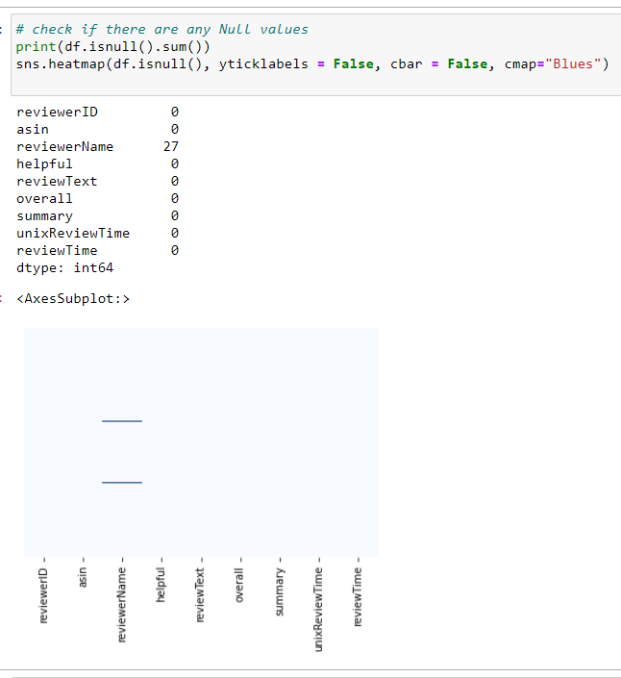
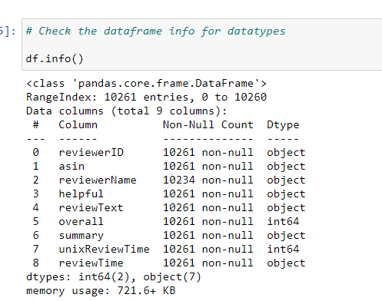
Descriptive Analysis and Analytics
We have used descriptive analysis in the ML Code that is summited to gain the incites of the data set
Understand the data types of the columns for data manipulations
Finding then null values present in data so as to determine the fixes

Slide 8
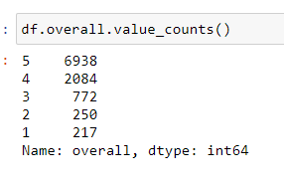
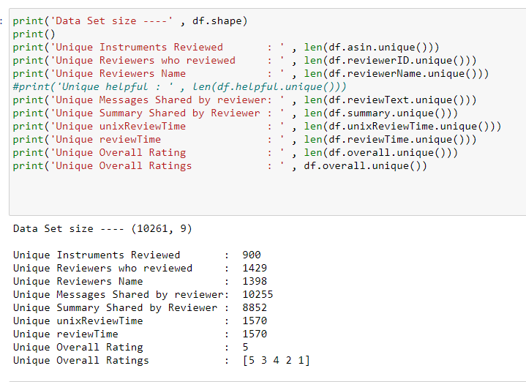
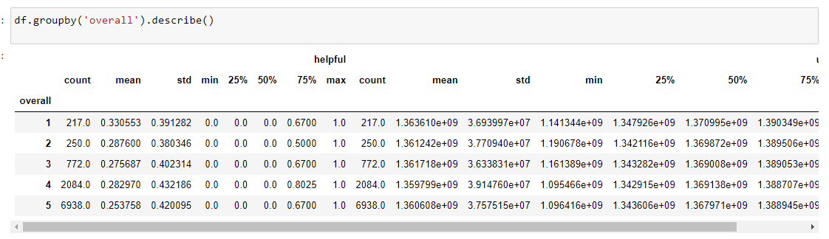
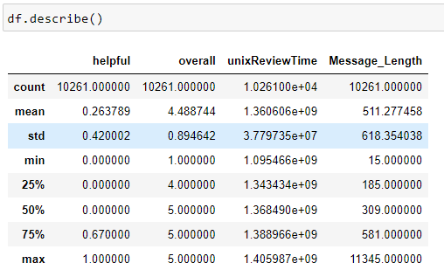
Descriptive Analysis and Analytics
Understand the data present in the columns
Understand the relations between dependent and independent variables
Understand data distribution of dependent and independent variables

Slide 9
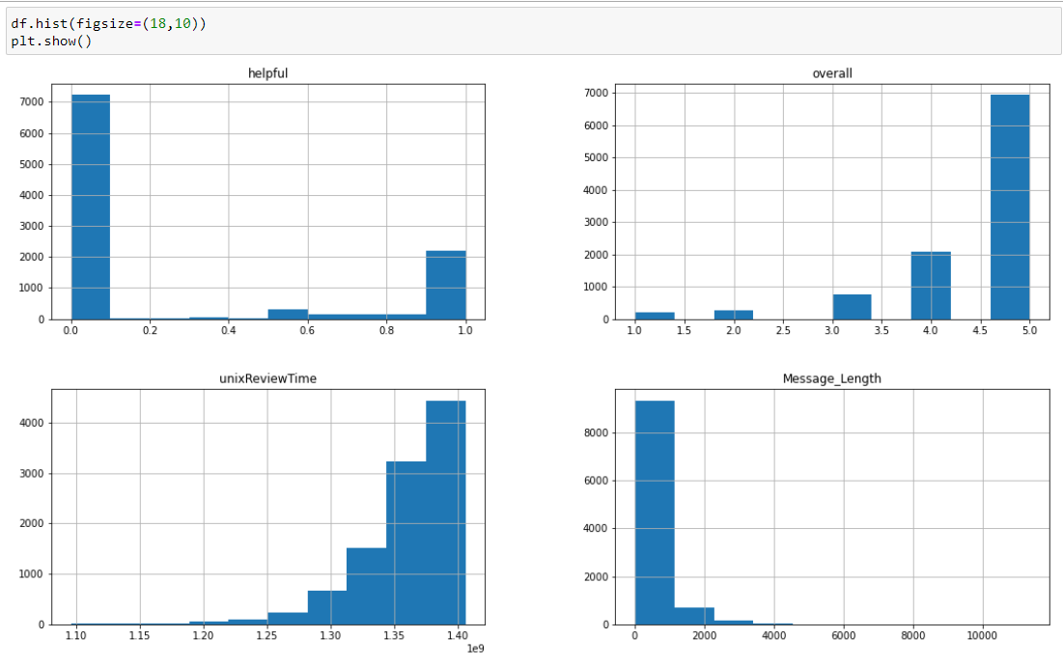
Descriptive Analysis and Visualizations
Histogram gives you the distribution view of the data in the respective column in dataset

Slide 10
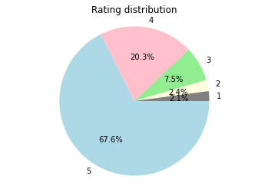
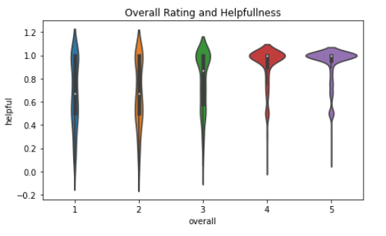
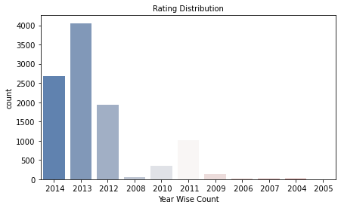
Analytical methodology
This fig below helps us understand the relation between helpful column and the rating column , determining that more the good reviews can be decided based on higher helpful rate
Understand the dependent variable distribution in data set
The figure help us understand the rating count started to rise with the years

Slide 11
Building ML Model
I have implemented 2 models for the given dataset , so as to compare the final resultset and choose the best of them for further predictions.
Model 1 : Logistic Regression Model
Model 2 : ANN Classifier Model
While training these models, various factors were considered and the model have been tunned with different hyperparameters so as to choose the best hyperparameter and get the maximum possible accuracy
Different Model Evaluation metrics are used like Confusion Metrix , ROC-AUC Curve , Accuracy Score, Precision Score , Recall Score and F1 Score.

Slide 12
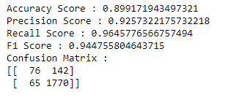
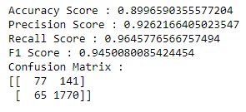
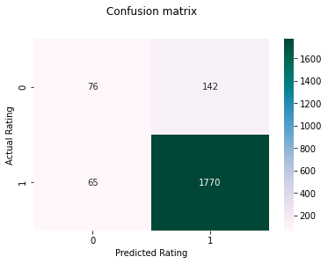

Model Evaluations
Model 1 : Logistic Regression Model
Model 2 : ANN Classifier Model

Slide 13
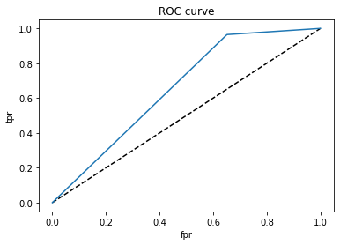
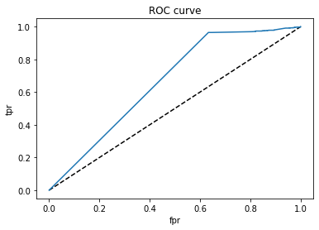

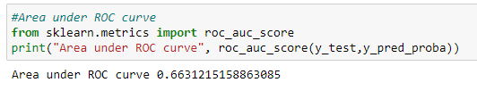
Model Evaluations
Model 1 : Logistic Regression Model
Model 2 : ANN Classifier Model

Slide 14

Proposed Next Steps
Data Set
This Model prepared is on textual data that is provided in the data set, we can include more data like reviewer demographics data ( Age, Gender, Occupation ) as well as other information like Purchased Products number of visits to the site etc…
EDA- Extract Data Analysis
Modeling & Evaluation
Deploying ML Model
Building a pipeline framework that can be deployed in a production environment for continuous training and testing.For eg. MLFlow can be used to deploy these models , where maintenance becomes easy job
In the project is build with 2 ML model , more models can be implemented and comparison can be done with them
Data transformations or more NLP techniques like TFIDF can be used
More Visualization's around the dataset can be included

Slide 15

- Sukruti Admuthe

